Slide 1
Speech Features

Slide 2
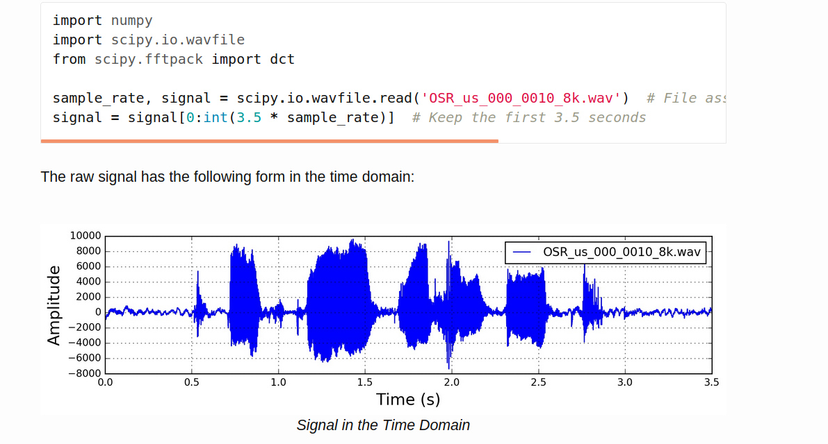
The time domain representation of sound

Slide 3
Framing
Typical frame sizes in speech processing range from 20 ms to 40 ms with 50% (+/-10%) overlap between consecutive frames. Popular settings are 25 ms for the frame size, frame_size = 0.025 and a 10 ms stride (15 ms overlap), frame_stride = 0.01.

Slide 4
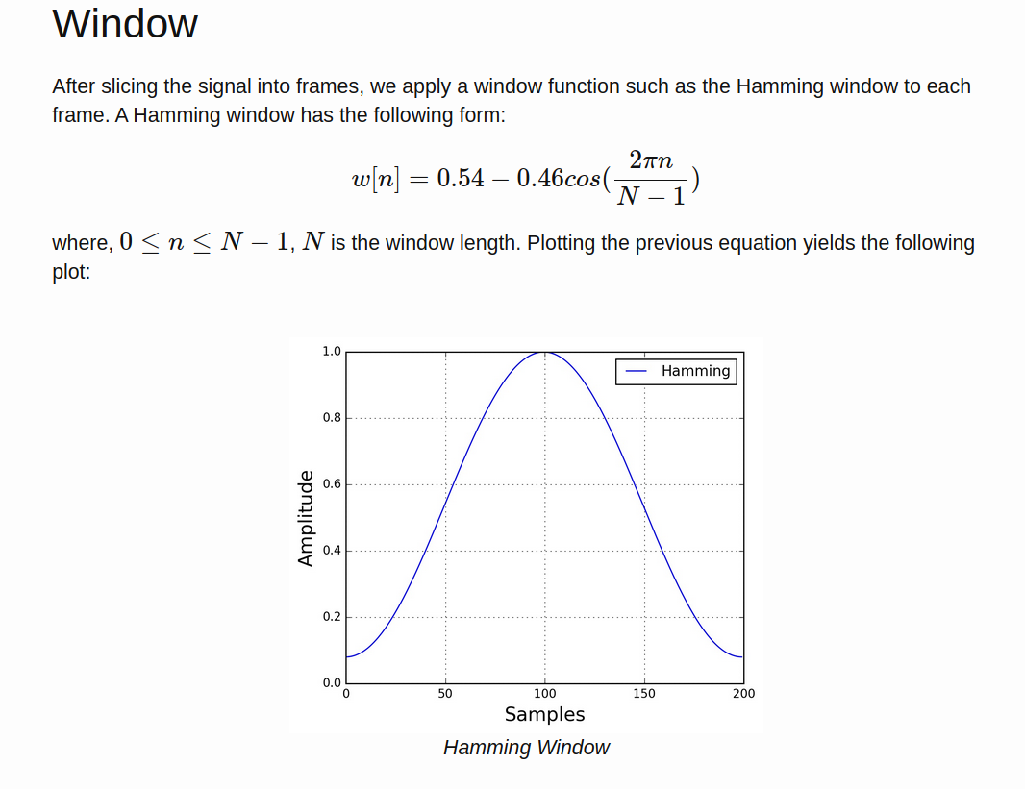

Slide 5
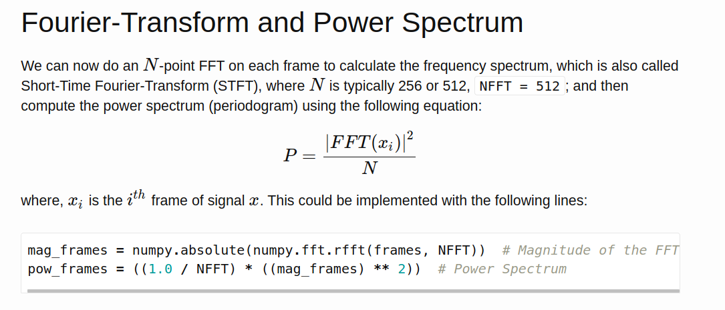

Slide 6
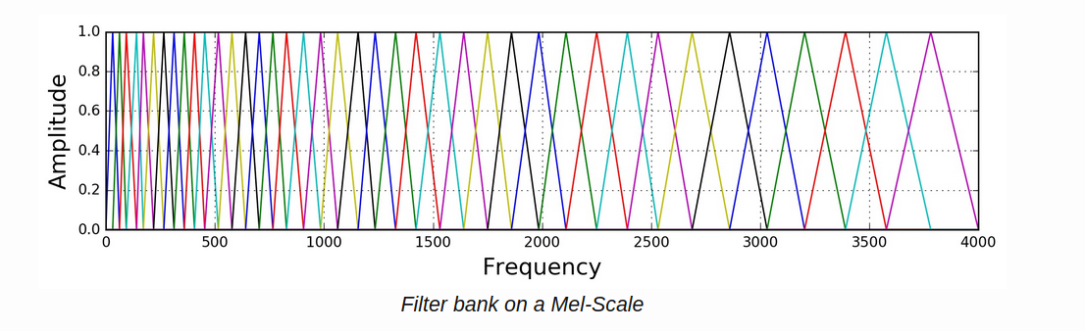
Mel spectrogram scale / filter bank

Slide 7
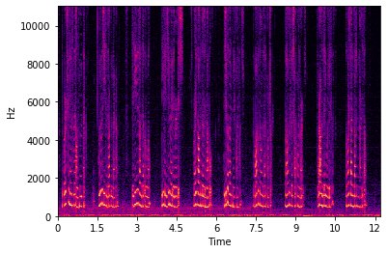
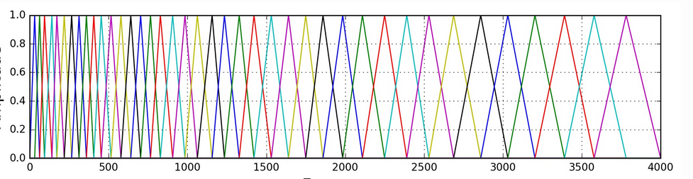

Slide 8
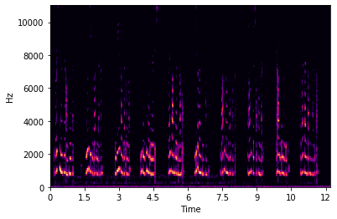
The result is the output of the filter

Slide 9
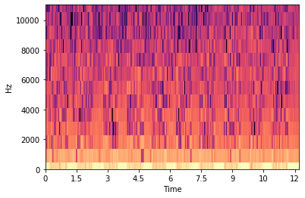
After doing DCT which does decorelation

